Slide 1
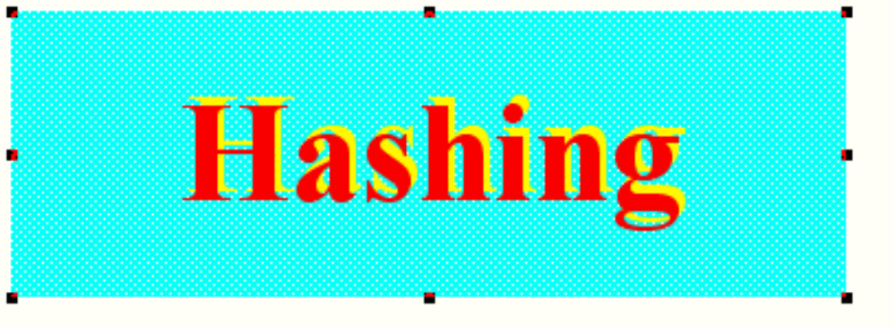

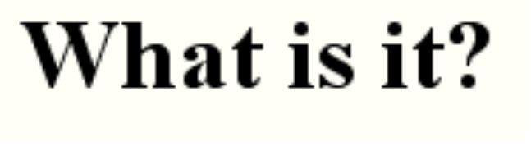
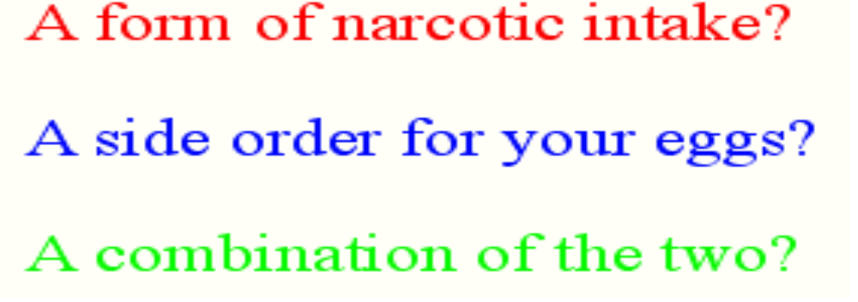

Slide 2
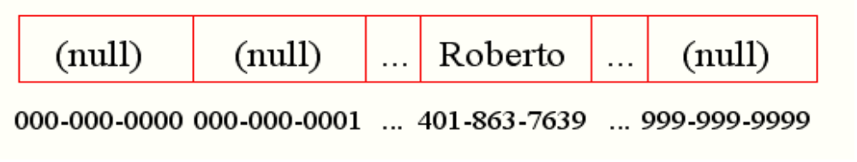
Problem
RT&T is a large phone company, and they want to provide enhanced caller ID capability:
  given a phone number, return the caller’s name
  phone numbers are in the range 0 to R = 10¹⁰-1
  n is the number of phone numbers used
  want to do this as efficiently as possible
We know two ways to design this dictionary:
-a balanced search tree (AVL, red-black) or a skip-list with the phone number as the key has O(log n) query time and O(n) space --- good space usage and search time, but can we reduce the search time to constant?
-a bucket array indexed by the phone number has optimal O(1) query time, but there is a huge amount of wasted space: O(n + R)

Slide 3
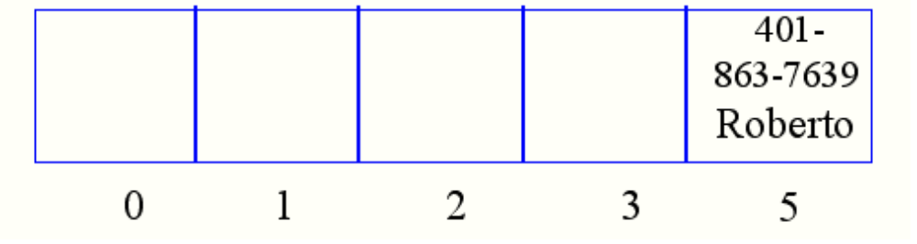
Another Solution
A Hash Table is an alternative solution with O(1) expected query time and O(n + N) space, where N is the size of the table
Like an array, but with a function to map the large range of keys into a smaller one
-e.g., take the original key, mod the size of the table, and use that as an index
Insert item (401-863-7639, Roberto) into a table of size 5
-4018637639 mod 5 = 4, so item (401-863-7639, Roberto) is stored in slot 4 of the table
  A lookup uses the same process: map the key to an index, then check the array cell at that index
  Insert (401-863-9350, Andy)
  And insert (401-863-2234, Devin). We have a collision!

Slide 4
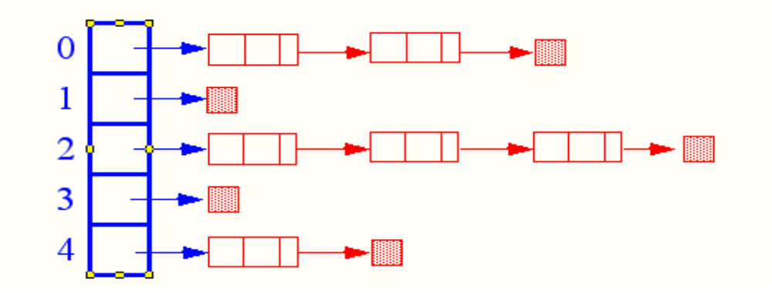
Collision Resolution
How to deal with two keys which map to the same cell of the array?
Use chaining
-Set up lists of items with the same index
The expected, search/insertion/removal time is
O(n/N), provided the indices are uniformly distributed
The performance of the data structure can be fine-tuned by changing the table size N

Slide 5
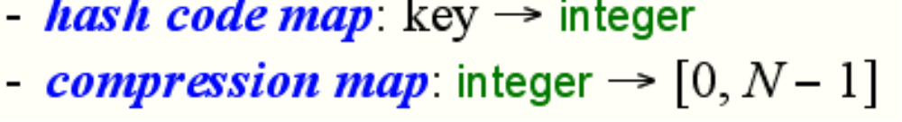
From Keys to Indices
The mapping of keys to indices of a hash table is called a hash function
A hash function is usually the composition of two maps, a hash code map and a compression map.
  An essential requirement of the hash function is to map equal keys to equal indices
  A “good” hash function minimizes the probability of collisions
Java provides a hashCode() method for the Object class, which typically returns the 32-bit memory address of the object.
This default hash code would work poorly for Integer and String objects
The hashCode() method should be suitably redefined by classes.

Slide 6
Popular Hash-Code Maps
Integer cast: for numeric types with 32 bits or less, we can reinterpret the bits of the nuber as an int
Component sum: for numeric types with more than 32 bits (e.g., long and double), we can add the 32-bit components.
Polynomial accumulation: for strings of a natural language, combine the character values (ASCII or Unicode) a₀a₁ ... a_{n-1} by viewing them as the coefficients of a polynomial:
a₀ + a₁x + ...+ x^{n-1}a_{n-1}
-The polynomial is computed with Horner’s rule, ignoring overflows, at a fixed value x:
a₀ + x (a₁ +x (a₂+ ... x (a_{n-2}+ x a_{n-1}) ... ))
-The choice x = 33, 37, 39, or 41gives at most 6 collisions on a vocabulary of 50,000 English words
Why is the component-sum hash code bad for strings?

Slide 7
Popular Compression Maps
Division: h(k) = |k| mod N
  the choice N = 2^{k} is bad because not all the bits are taken into account
  the table size N is usually chosen as a prime number
  certain patterns in the hash codes are propagated
Multiply, Add, and Divide (MAD): h(k) = |ak + b| mod N
  eliminates patterns provided a mod N π 0
  same formula used in linear congruential (pseudo) random number generators

Slide 8

More on Collisions
A key is mapped to an already occupied table location
-what to do?!?
Use a collision handling technique
We’ve seen Chaining
Can also use Open Addressing
-Double Hashing
-Linear Probing

Slide 9
Linear Probing
If the current location is used, try the next table location
  linear_probing_insert(K)
  if (table is full) error
  probe = h(K)
  while (table[probe] occupied)
  probe = (probe + 1) mod M
  table[probe] = K
Lookups walk along table until the key or an empty slot is found
Uses less memory than chaining. (Don’t have to store all those links)
Slower than chaining. (May have to walk along table for a long way.)
Deletion is more complex. (Either mark the deleted slot or fill in the slot by shifting some elements down.)

Slide 10
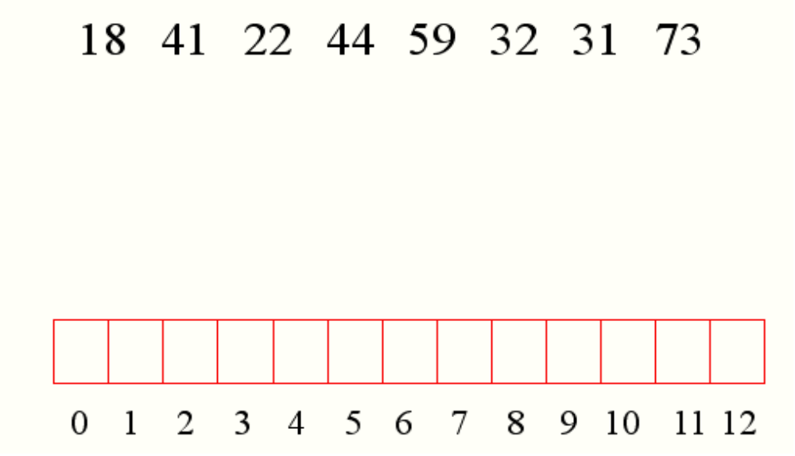
Linear Probing Example
h(k) = k mod 13
Insert keys:
31
73
44
32
41
18
44
59
32
22
31
73

Slide 11
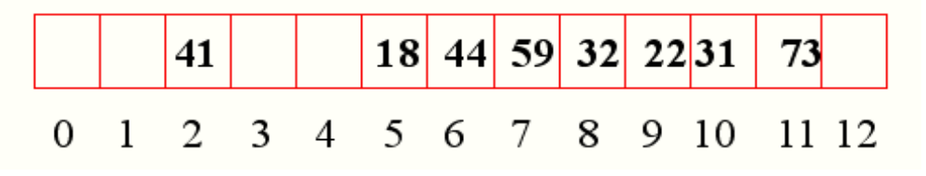
Linear Probing Example (cont.)

Slide 12
Quadratic Probing
If h(x) is full, look for h(x)+1*1, h(x) + 2*2,
h(x)+3*3, and so on (all computations mod table size).

Slide 13
Double Hashing
Use two hash functions
If M is prime, eventually will examine every position in the table
double_hash_insert(K)
if(table is full) error
probe = h1(K)
offset = h2(K)
while (table[probe] occupied)
probe = (probe + offset) mod M
table[probe] = K
Many of same (dis)advantages as linear probing
Distributes keys more uniformly than linear probing does

Slide 14
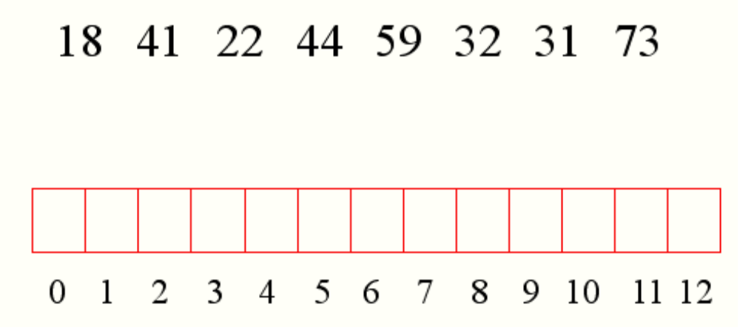
Double Hashing Example
h₁(K) = K mod 13
h₂ (K) = 8 - K mod 8
we want h₂ to be an offset to add

Slide 15
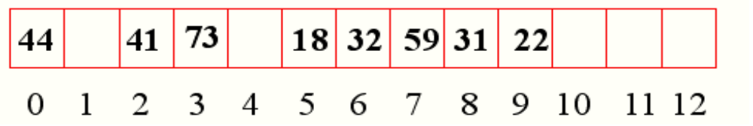
Double Hashing Example (cont.)

Slide 16
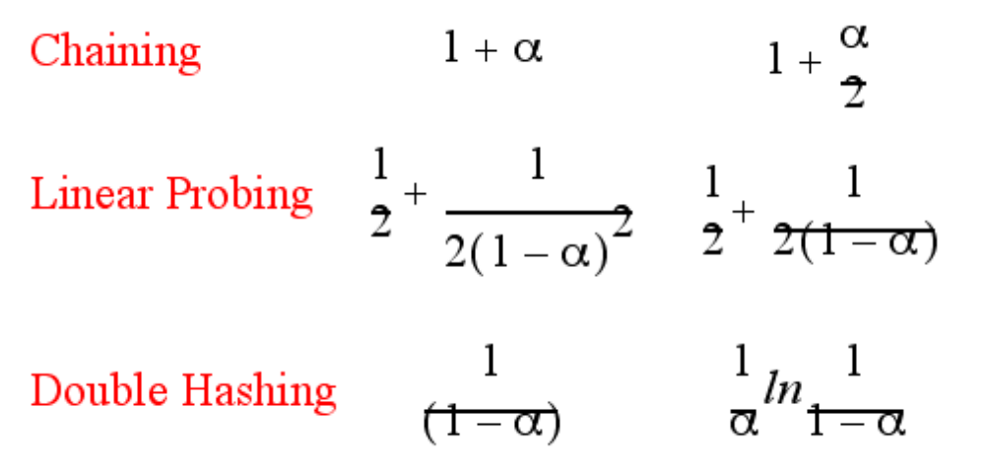
Theoretical Results
Let α = N/M
the load factor: average number of keys per array index
Analysis is probabilistic, rather than worst-case
Expected Number of Probes
Not found
found

Slide 17
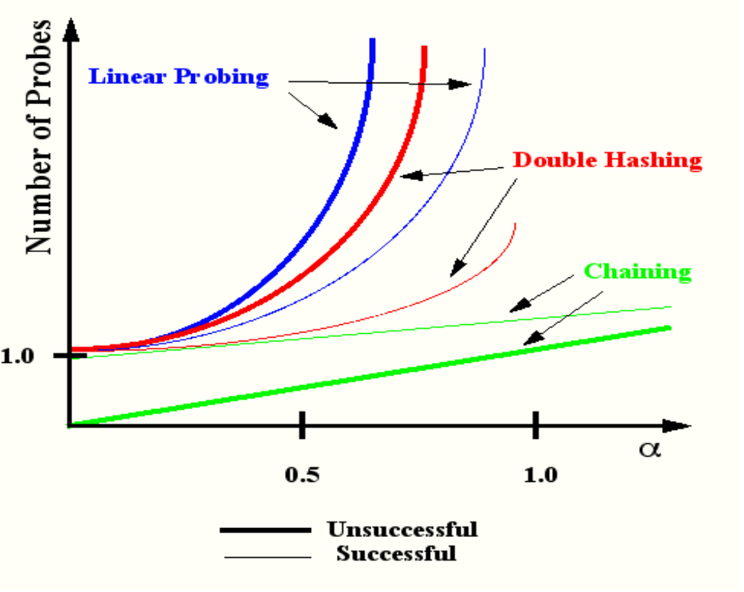
Expected Number of Probes vs. Load Factor

